Slide 1
Learning & Development Enabling development, Impacting growth…
BIG-04
BIG DATA OVERVIEW – Module 01

Slide 2
Module Outline
What’s Big Data?
Big Data: 3V’s
Explosion of Data
What’s driving Big Data
Applications for Big Data Analytics
Big Data Use Cases
Benefits of Big Data
Q & A

Slide 3
What’s Big Data?
No single definition; here is from Wikipedia:
Big data is the term for a collection of data sets so large and complex that it becomes difficult to process using on-hand database management tools or traditional data processing applications.
The challenges include capture, curation, storage, search, sharing, transfer, analysis, and visualization.
The trend to larger data sets is due to the additional information derivable from analysis of a single large set of related data, as compared to separate smaller sets with the same total amount of data, allowing correlations to be found to "spot business trends, determine quality of research, prevent diseases, link legal citations, combat crime, and determine real-time roadway traffic conditions.”

Slide 4
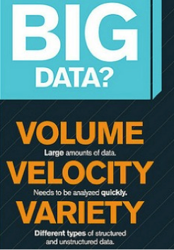

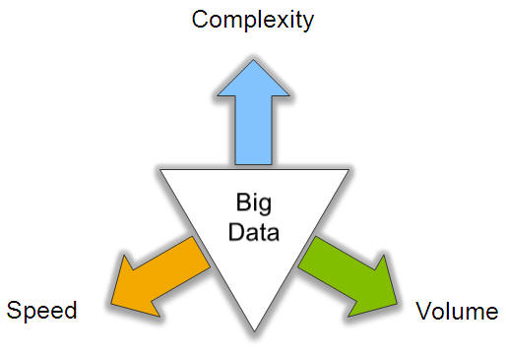
Big Data: 3V’s

Slide 5
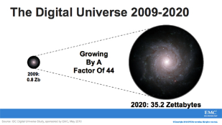
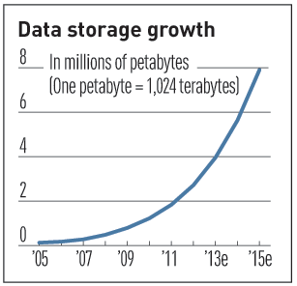

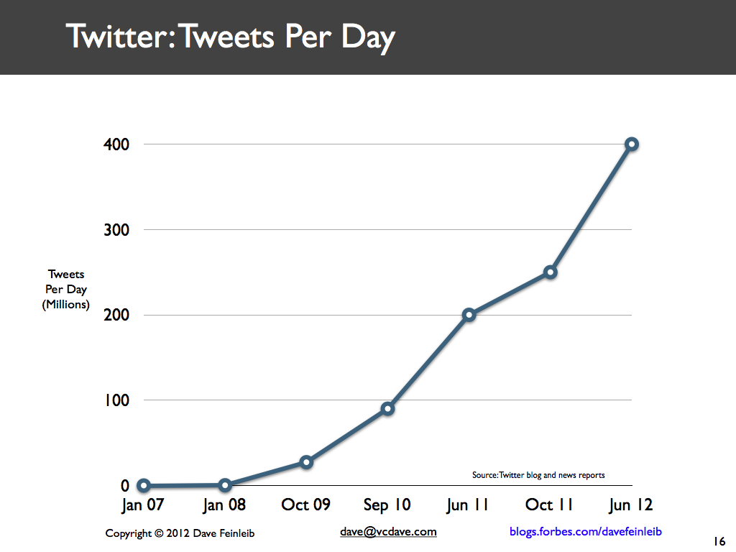
Volume (Scale)
Data Volume
44x increase from 2009 2020
From 0.8 zettabytes to 35zb
Data volume is increasing exponentially
Exponential increase in collected/generated data

Slide 6
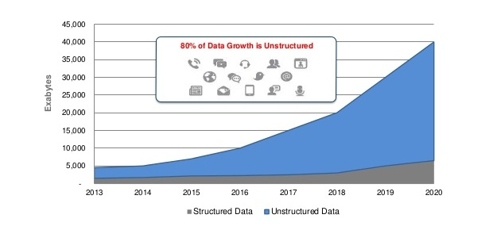
Volume (continued)
By 2020, International Data Corporation predicts the number will reach 40,000 EB, or 40 Zettabytes (ZB) .
The world’s information is doubling every two years. By 2020, there will be 5,200 GB of data for every person on Earth.
By 2020, the amount of high-value data worth analyzing will double and 60% of information delivered to decision makers will be actionable.

Slide 7
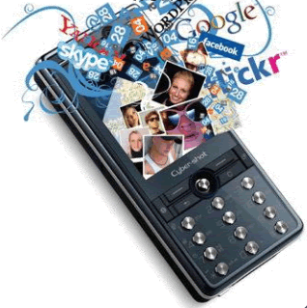


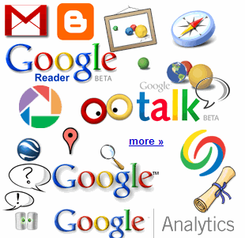

Data Sources for large volume
4.6 billion camera phones world wide
30 billion RFID tags today (1.3B in 2005)
12+ TBs of tweet data every day
100s of millions of GPS enabled devices sold annually
? TBs of data every day
25+ TBs of log data every day
2+ billion people on the Web by end 2011

Slide 8
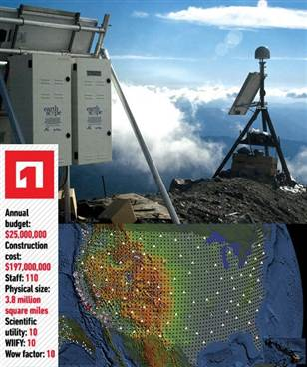
Volume(continued)…The Earthscope
1.
The Earthscope is the world's largest science project. Designed to track North America's geological evolution, this observatory records data over 3.8 million square miles, amassing 67 terabytes of data. It analyzes seismic slips in the San Andreas fault, sure, but also the plume of magma underneath Yellowstone and much, much more.
(http://www.msnbc.msn.com/id/44363598/ns/technology_and_science-future_of_technology/#.TmetOdQ--uI)

Slide 9

Velocity (Speed)
Velocity: Speed at which data is generating day by day
Data is being generated fast and need to be processed fast
Online Data Analytics
Late decisions ➔ missing opportunities
Examples
E-Promotions: Based on your current location, your purchase history, what you like ➔ send promotions right now for store next to you
Healthcare monitoring: sensors monitoring your activities and body ➔ any abnormal measurements require immediate reaction

Slide 10
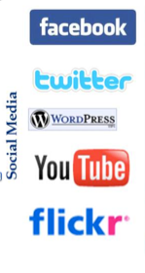
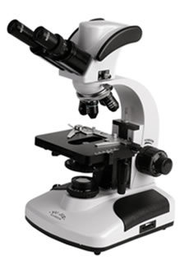

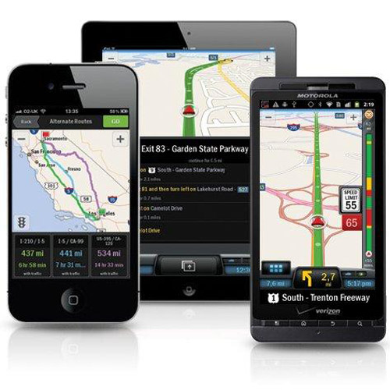
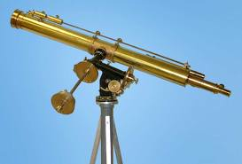
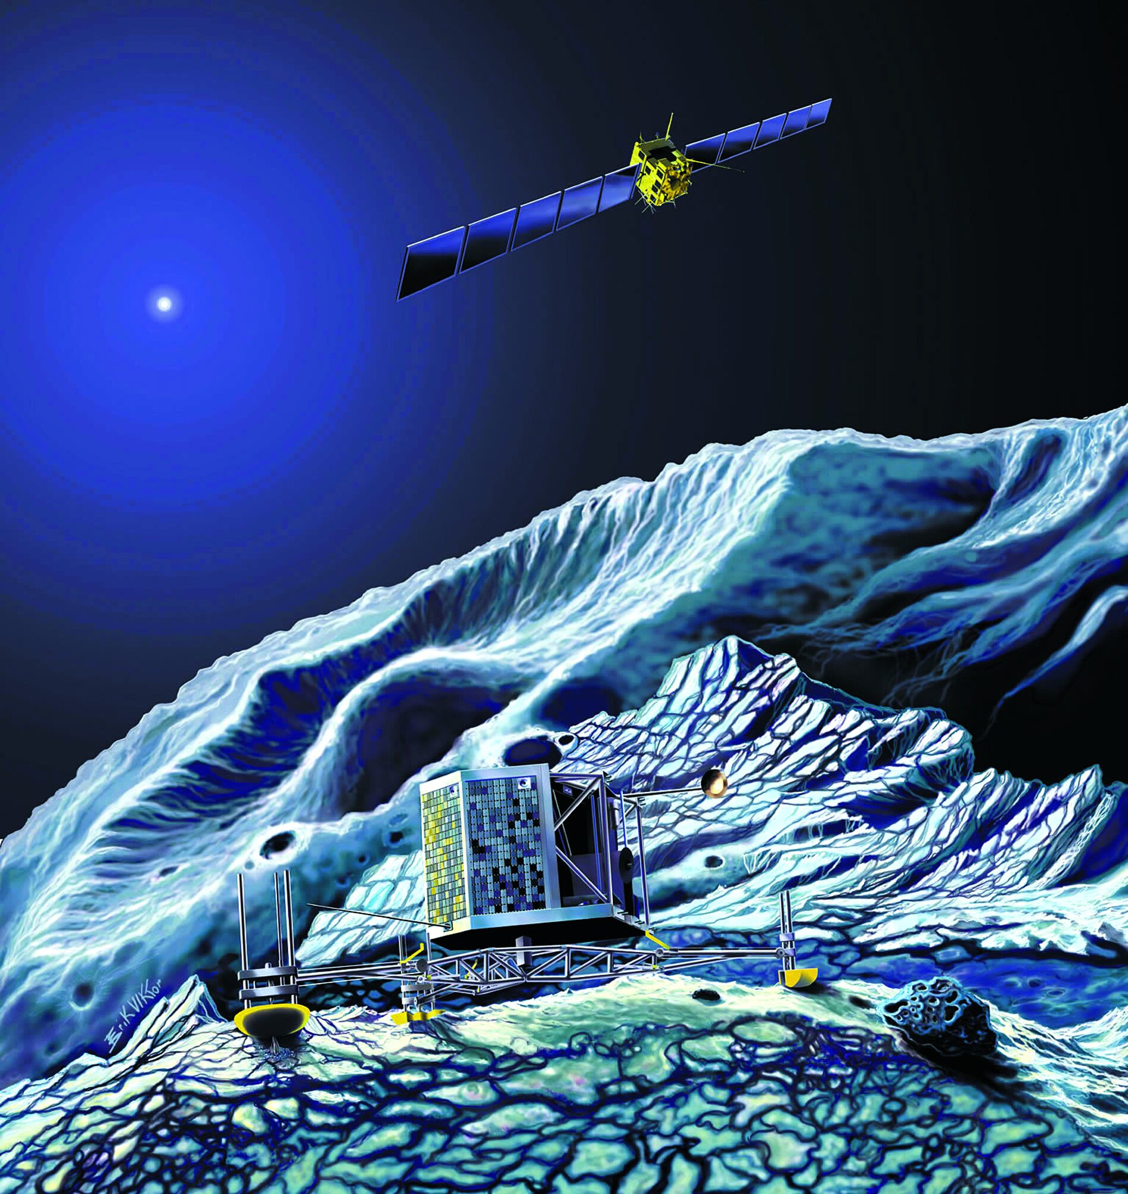
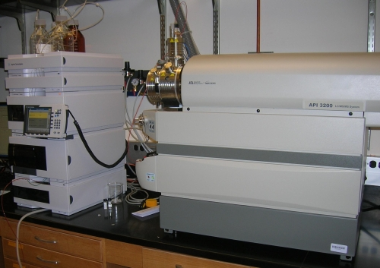
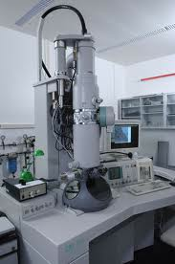
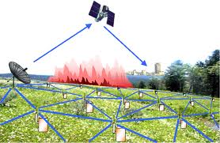
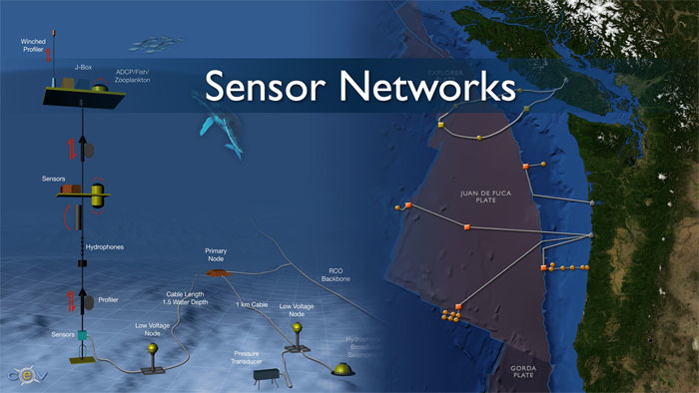
Velocity(continued)…Real-time/Fast Data
Mobile devices
(tracking all objects all the time)
Social media and networks
(all of us are generating data)
Scientific instruments
(collecting all sorts of data)
Sensor technology and networks
(measuring all kinds of data)
The progress and innovation is no longer hindered by the ability to collect data
But, by the ability to manage, analyze, summarize, visualize, and discover knowledge from the collected data in a timely manner and in a scalable fashion

Slide 11
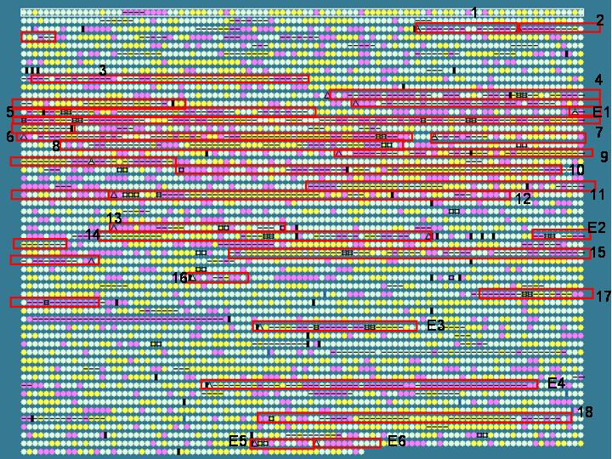
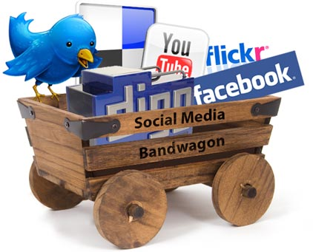
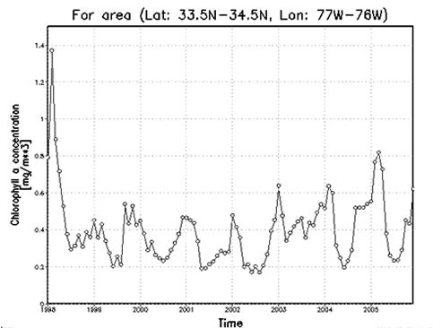
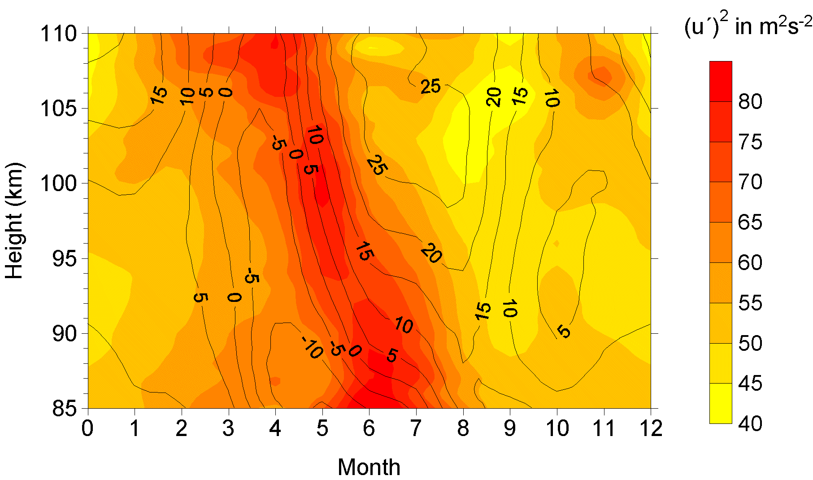


Variety (Complexity)
Relational Data (Tables/Transaction/Legacy Data)
Text Data
XML Data
Streaming Data
Data changing within fraction of seconds
Audio Data
Video Data
Logs Data
Graph Data
Social Network
A single application may generate/collect different types of data
Big Public Data (online, weather, finance, etc)
To extract knowledge➔ All these types of data need to linked together

Slide 12
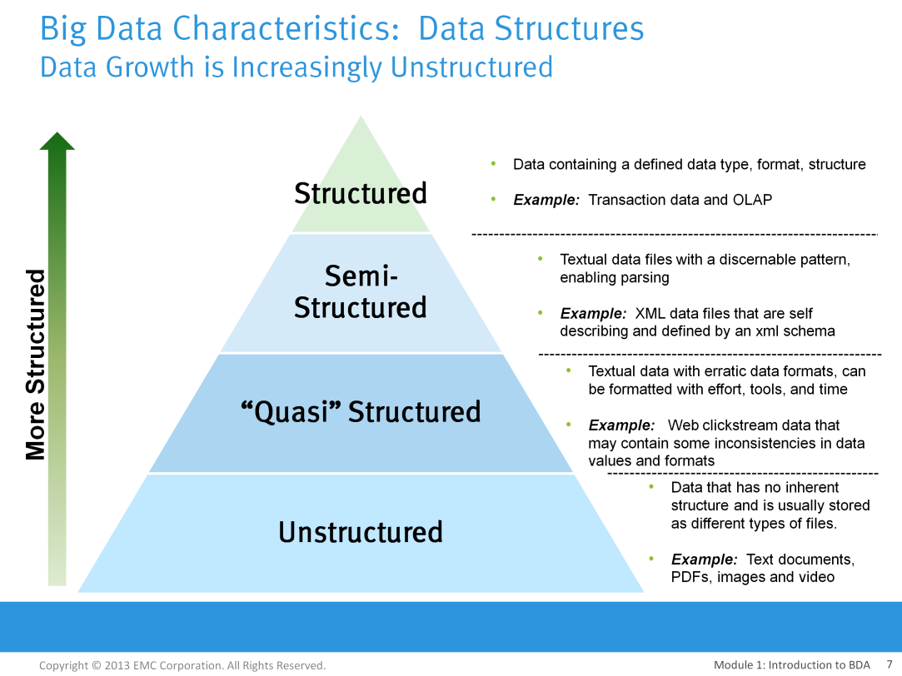
Variety(continued)…Types of Data in Big Data

Slide 13
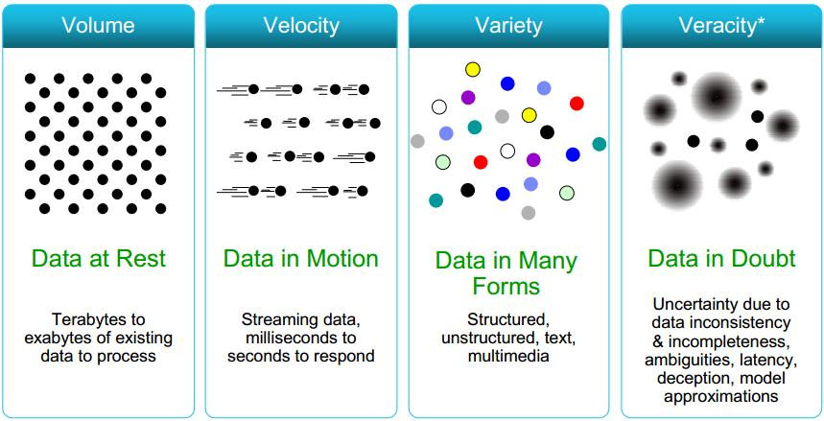
Some Make it 4V’s

Slide 14
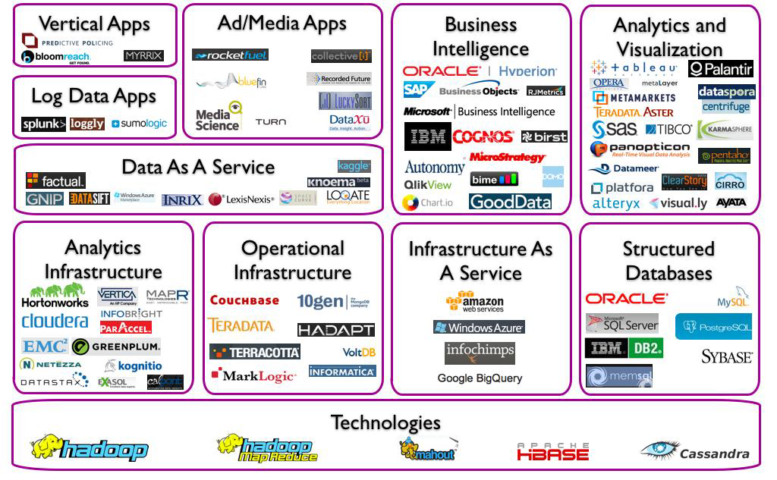
The Big Data Landscape

Slide 15
Quiz
1. What type of data Big Data deals with?
Only Structured data
Only Unstructured data
All types of Data
2. Which of following characteristic of big data deals with Speed?
Volume
Variety
Velocity

Slide 16
Quiz-Answers
1. What type of data Big Data deals with?
Only Structure data
Only Unstructured data
All types of Data
2. Which of following charactistics of big data deals with Speed?
Volume
Variety
Velocity
C: All types of Data
C: Velocity

Slide 17
Quiz(continued)
3. Map each of the below data as structured ,semi structured or unstructured.
PDF
E-mail
Database table
XML

Slide 18
Quiz-Answer
3. Map each of the below data as structured ,semi structured or unstructured.
PDF
E-mail
Database tables
XML
PDF→ Unstructured
E-mail → Unstructured
Database tables → Structured
XML File → Semi structured

Slide 19

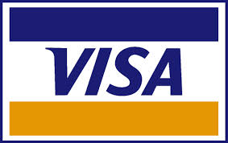















Explosion of Data- A Single View to the Customer
Social Media
Banking
Finance
Gaming
Our
Known
History
Customer
Entertain
Purchase
Notes:
Now a days, a single person is connected to social media like facebook, twitter etc bank transactions, online games, online entertainment channels like Netflix, hulu and online shopping which in turn generating a lot of data.

Slide 20
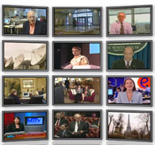

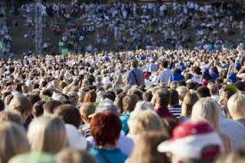

Explosion of Data(continued)- The Model Has Changed…
The Model of Generating/Consuming Data has Changed
Old Model: Few companies are generating data, all others are consuming data
New Model: all of us are generating data, and all of us are consuming data

Slide 21
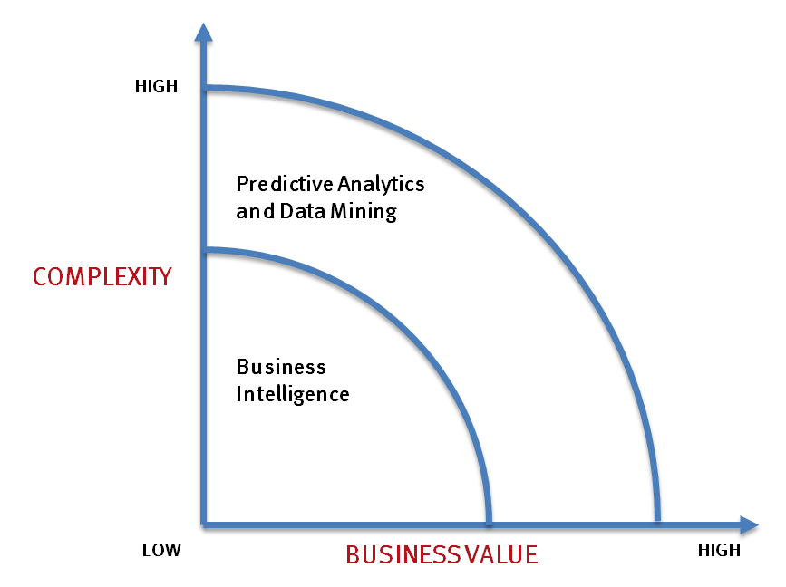
What’s driving Big Data
- Optimizations and predictive analytics
- Complex statistical analysis
- All types of data, and many sources
- Very large datasets
- More of a real-time
- Ad-hoc querying and reporting
- Data mining techniques
- Structured data, typical sources
- Small to mid-size datasets

Slide 22
What is really innovative behind the Big Data buzz word ?
Hadoop & Cloud : Low cost ways to store, manage and analyze massive volumes of data
No SQL : New ways to organize and analyze non-structured data
Cost
Event Processing tools : Ability to analyze and detect trends in real time streaming events (monitoring, Next Best Action, Fraud...)
In-memory technologies : A new way to guarantee response time even for very complex calculations
Speed
Explosion of Analytics usage : R is open source, High performance statistics make them usable by every needed process
Multiple external data sources : Easier to tackle new data sources e.g. social media, traffic, GPS sensors, open data.
Insights

Slide 23

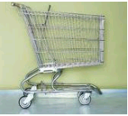


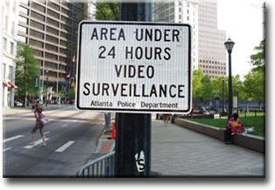
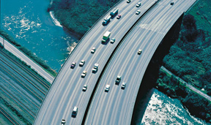
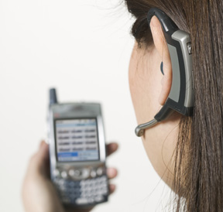

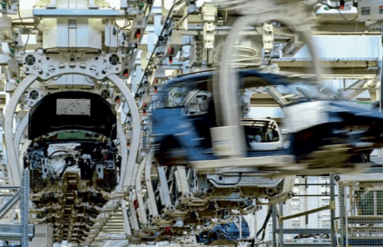
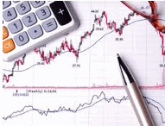
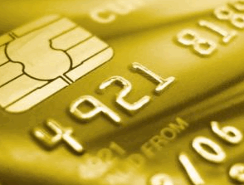

Applications for Big Data Analytics
Smarter Healthcare
Multi-channel sales
Finance
Log Analysis
Homeland Security
Traffic Control
Telecom
Search Quality
Manufacturing
Trading Analytics
Fraud and Risk
Retail: Churn

Slide 24
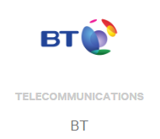


Big Data Use Cases
Telecommunications
Network Performance Optimization
Customer churn prevention
Call records analysis
Healthcare
Gathering patient’s complete information
Service quality improvements
Personalized treatment planning
Banking and Financial Services
Fraud Detection
Customer segmentation analysis
Credit risk assessment
Notes:
UC Irvine Health(UCIH) is using bigdata-hadoop to gather all the clinical information scattered across multiple spreadsheets and making it searchable.
JP Morgan is using bigdata-hadoop to deliver best set of products they can deliver to customer i.e. customer segmentation.

Slide 25



Big Data Use Cases(continued)
Retail
Customer churn prevention
Point of sales transaction analysis
360 degree customer view
E-commerce
Click stream analysis
Recommendation engine
Ad targeting
Government Sector
UID enrollment
Social welfare schemes
Notes:
Walmart has an application Savings Catcher: that alerts the customers whenever its neighboring competitor reduces the cost of an item the customer already bought. This application then sends a gift voucher to the customer to compensate the price difference.
Source: https://www.dezyre.com/article/how-big-data-analysis-helped-increase-walmart-s-sales-turnover/109
Ebay uses for click stream analysis.
Hadoop is used in Aadhar enrollment where citizen’s data like personal details, photograph, retina etc is stored.

Slide 26

Benefits of Big Data
Increase in operational efficiency
Improved strategic direction
Better customer service
Enhanced customer experience
Early identification of business opportunities
Reduced time to market
Compliance with regulations

Slide 27
Quiz
Name different types of data in big-data.
Structured and Semi-structured
Quasi-Structured and Unstructured
None of the above
A&B

Slide 28
Quiz-Answer
Name different types of data in big-data.
Structured and Semi-structured
Quasi-Structured and Unstructured
None of the above
A&B
D: A & B

Slide 29
Q & A

